Slide 1

332:479 Concepts in VLSI
Design
Lecture 27
Scaling
David Harris
Harvey Mudd College
Spring 2004

Slide 2
Outline
Scaling
  Transistors
  Interconnect
  Future Challenges
Summary
Material from: CMOS VLSI Design,
by Weste and Harris, Addison-Wesley, 2005

Slide 3
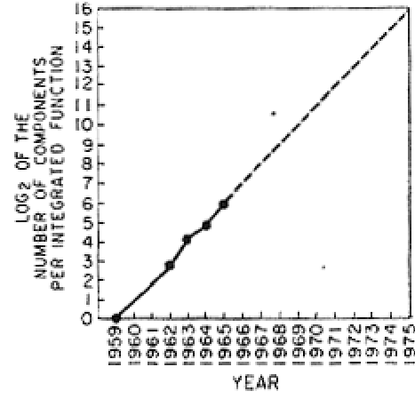
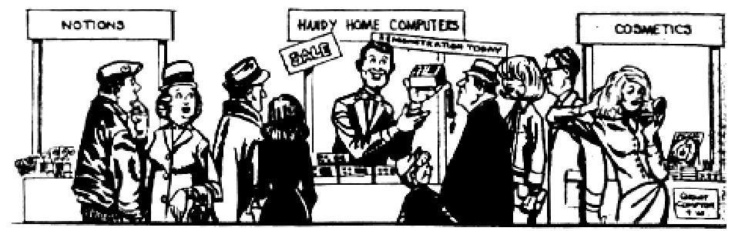
Moore’s Law
In 1965, Gordon Moore predicted the exponential growth of the number of transistors on an IC
Transistor count doubled
every year since invention
Predicted > 65,000
transistors by 1975!
Growth limited by power
[Moore65]

Slide 4
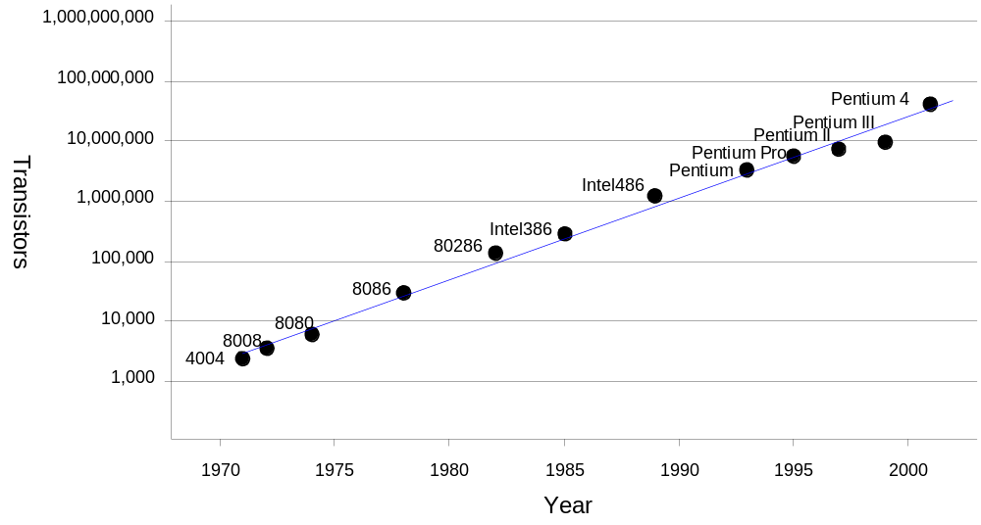
More Moore
Transistor counts have doubled every 26 months for the past three decades.

Slide 5
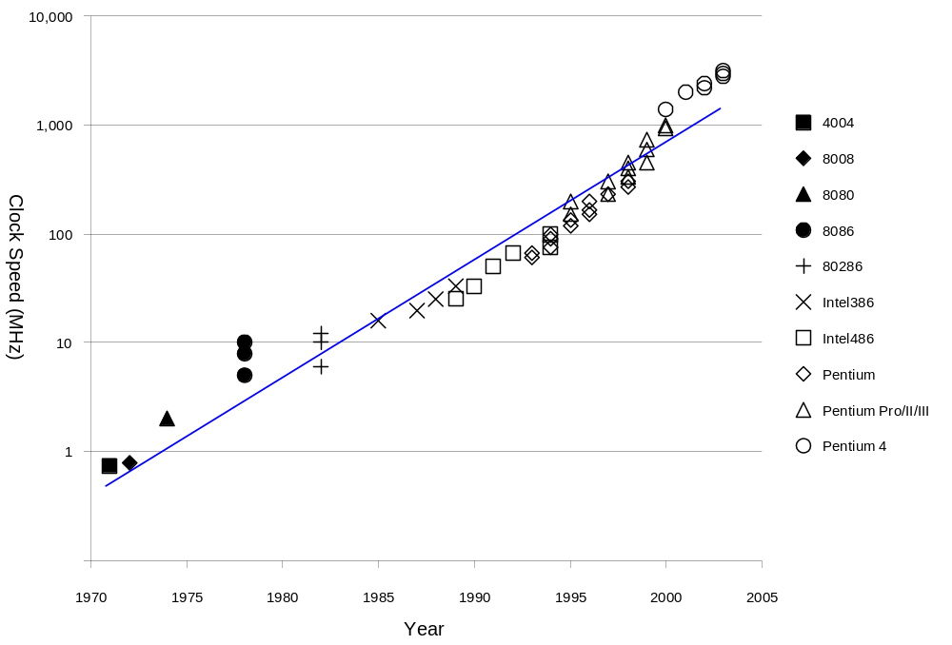
Speed Improvement
Clock frequencies have also increased exponentially
  A corollary of Moore’s Law

Slide 6
Why?
Why more transistors per IC?
Why faster computers?

Slide 7
Why?
Why more transistors per IC?
  Smaller transistors
  Larger dice
Why faster computers?

Slide 8
Why?
Why more transistors per IC?
  Smaller transistors
  Larger dice
Why faster computers?
  Smaller, faster transistors
  Better microarchitecture (more IPC)
  Fewer gate delays per cycle

Slide 9
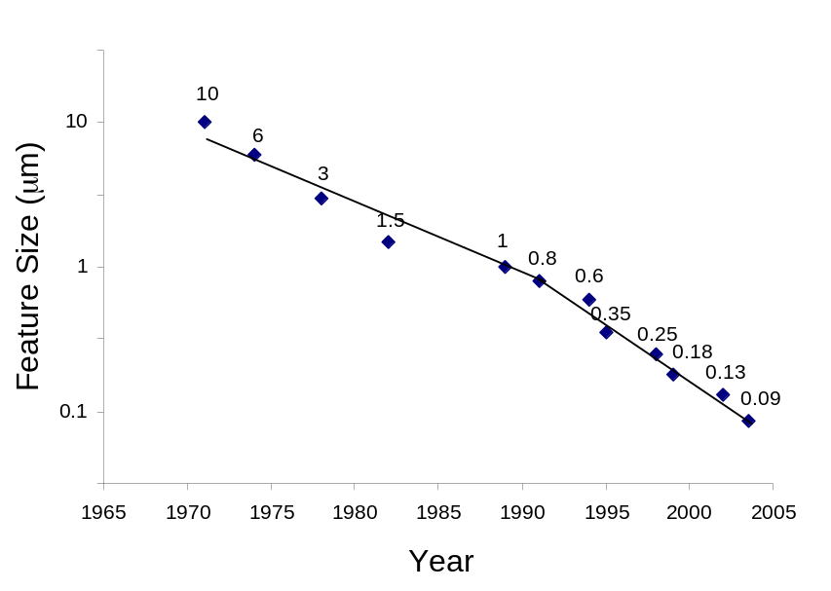

Scaling
The only constant in VLSI is constant change
Feature size shrinks by 30% every 2-3 years
  Transistors become cheaper
  Transistors become faster
  Wires do not improve
  (and may get worse)
Scale factor S
  Typically
  Technology nodes

Slide 10
Scaling Assumptions
What changes between technology nodes?
Constant Field Scaling by α
  All dimensions (x, y, z => W, L, t_{ox})
  Voltage (V_{DD})
  Doping levels
Lateral Scaling
  Only gate length L
  Often done as a quick gate shrink (S = 1.05)

Slide 11
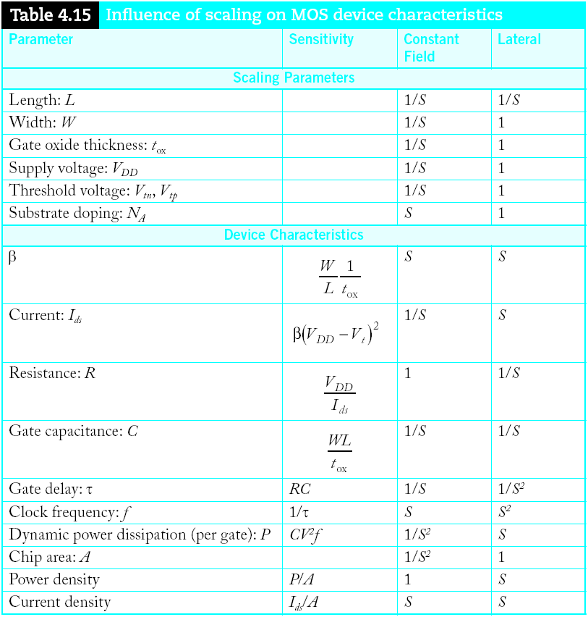
Device Scaling

Slide 12
Device Scaling

Slide 13
Device Scaling

Slide 14
Device Scaling

Slide 15
Device Scaling

Slide 16
Device Scaling

Slide 17
Device Scaling

Slide 18
Device Scaling

Slide 19
Device Scaling

Slide 20
Device Scaling

Slide 21
Device Scaling

Slide 22
Device Scaling

Slide 23
Observations
Gate capacitance per micron is nearly independent of process
But ON resistance * micron improves with process
Gates get faster with scaling (good)
Dynamic power goes down with scaling (good)
Current density goes up with scaling (bad)
Velocity saturation makes lateral scaling unsustainable

Slide 24
Scaling Problems
Depletion regions determine how small the channel can get
  Source-drain length > 2 depletion layer widths
  Can reduce depletion layer width by increasing substrate doping
Constant Field Scaling – get:
  I_{ds} / α
  But α² devices / per area
  Therefore, current density goes up by α

Slide 25
Example
Gate capacitance is typically about 2 fF/μm
The FO4 inverter delay in the TT corner for a process of feature size f (in nm) is about 0.5f ps
Estimate the ON resistance of a unit (4/2 λ) transistor.

Slide 26
Solution
Gate capacitance is typically about 2 fF/μm
The FO4 inverter delay in the TT corner for a process of feature size f (in nm) is about 0.5f ps
Estimate the ON resistance of a unit (4/2 λ) transistor.
FO4 = 5 τ = 15 RC
RC = (0.5f) / 15 = (f/30) ps/nm
If W = 2f, R = 8.33 kΩ
  Unit resistance is roughly independent of f

Slide 27
Scaling Assumptions
Wire thickness
  Hold constant vs. reduce in thickness
Wire length
  Local / scaled interconnect
  Global interconnect
    Die size scaled by D_{c} ≈ 1.1

Slide 28
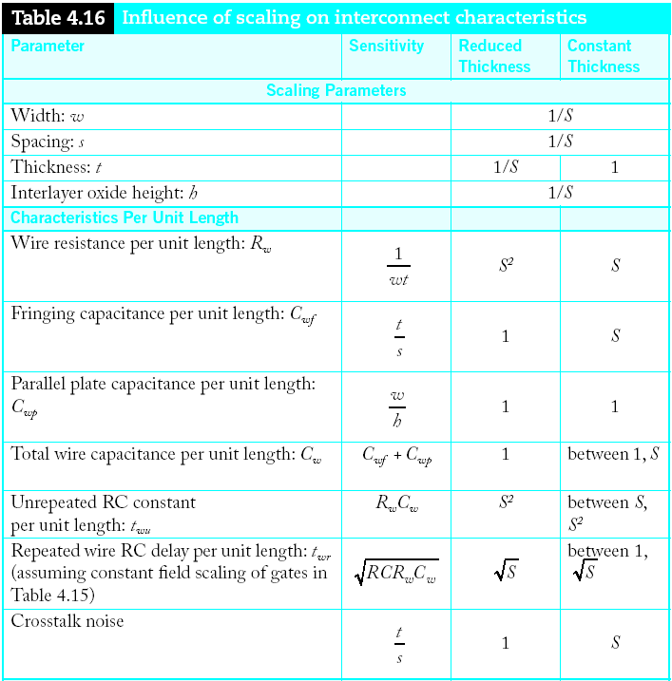
Interconnect Scaling

Slide 29
Interconnect Scaling

Slide 30
Interconnect Scaling

Slide 31
Interconnect Scaling

Slide 32
Interconnect Scaling

Slide 33
Interconnect Scaling

Slide 34
Interconnect Scaling

Slide 35
Interconnect Scaling

Slide 36
Interconnect Scaling

Slide 37
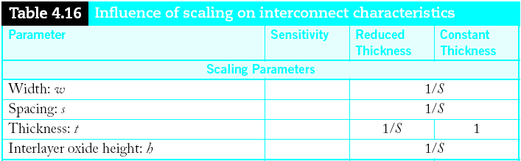
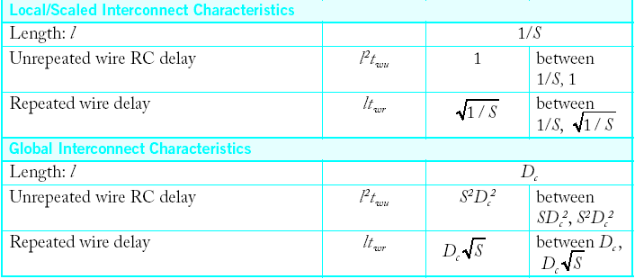
Interconnect Delay

Slide 38
Interconnect Delay

Slide 39
Interconnect Delay

Slide 40
Interconnect Delay

Slide 41
Interconnect Delay

Slide 42
Interconnect Delay

Slide 43
Interconnect Delay

Slide 44
Observations
Capacitance per micron is remaining constant
  About 0.2 fF/μm
  Roughly 1/10 of gate capacitance
Local wires are getting faster
  Not quite tracking transistor improvement
  But not a major problem
Global wires are getting slower
  No longer possible to cross chip in one cycle

Slide 45
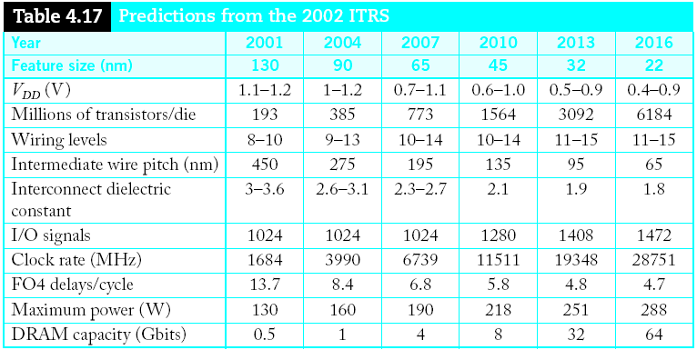
ITRS
Semiconductor Industry Association forecast
  Intl. Technology Roadmap for Semiconductors

Slide 46
Scaling Implications
Improved Performance
Improved Cost
Interconnect Woes
Power Woes
Productivity Challenges
Physical Limits

Slide 47
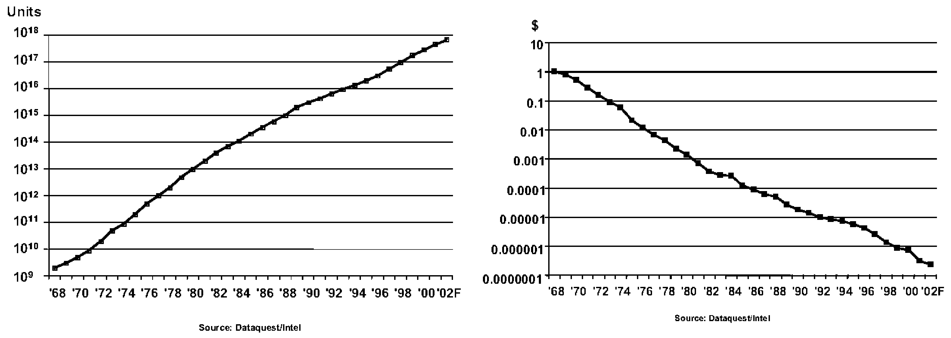
Cost Improvement
In 2003, $0.01 bought you 100,000 transistors
  Moore’s Law is still going strong
[Moore03]

Slide 48
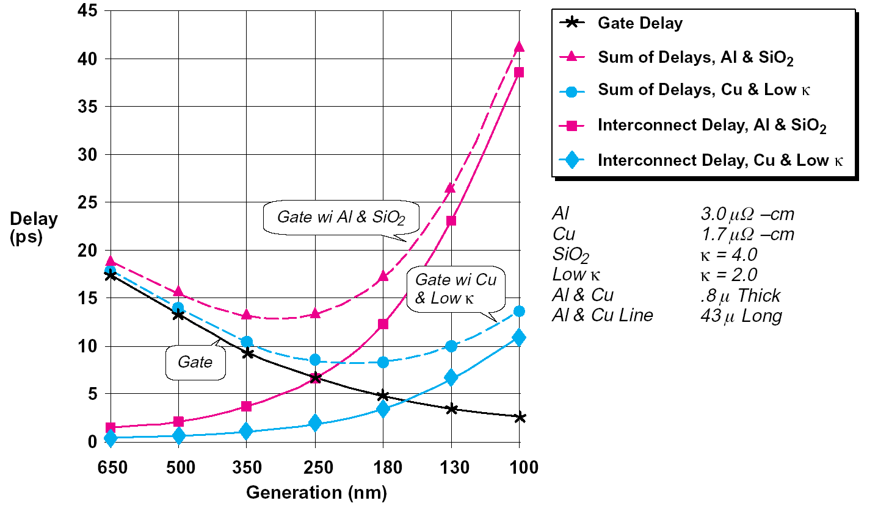
Interconnect Woes
SIA made a gloomy forecast in 1997
  Delay would reach minimum at 250 – 180 nm, then get worse because of wires
But…
[SIA97]

Slide 49
Interconnect Woes
SIA made a gloomy forecast in 1997
  Delay would reach minimum at 250 – 180 nm, then get worse because of wires
But…
  Misleading scale
  Global wires
100 kgate blocks ok

Slide 50
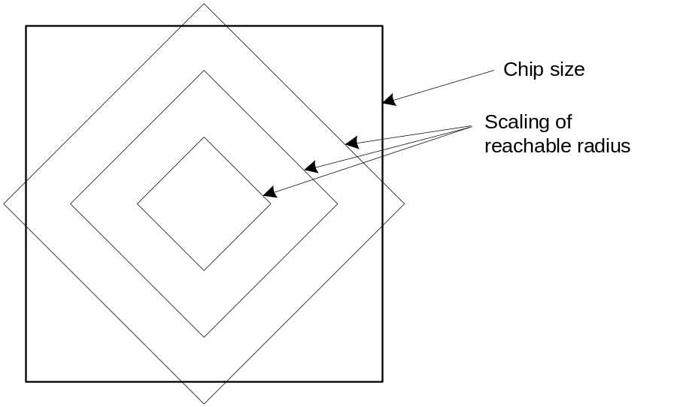
Reachable Radius
We can’t send a signal across a large fast chip in one cycle anymore
But the microarchitect can plan around this
  Just as off-chip memory latencies were tolerated

Slide 51
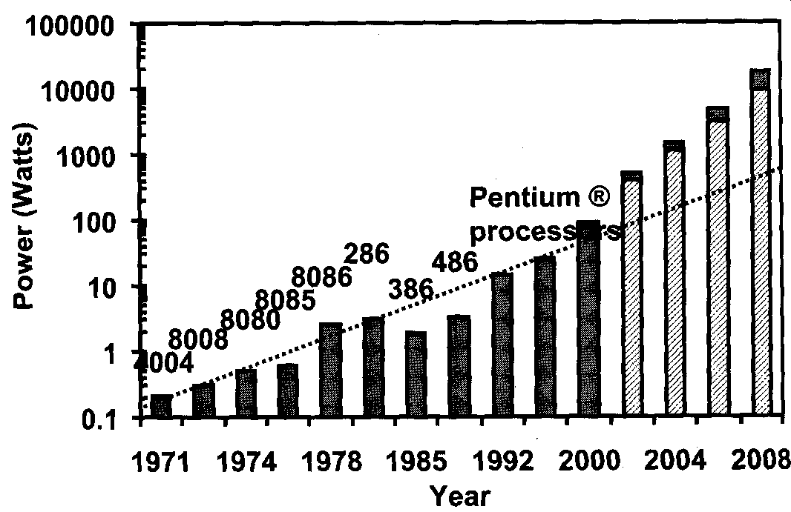
Dynamic Power
Intel VP Patrick Gelsinger (ISSCC 2001)
  If scaling continues at present pace, by 2005, high speed processors would have power density of nuclear reactor, by 2010, a rocket nozzle, and by 2015, surface of sun.
  “Business as usual will not work in the future.”
Intel stock dropped 8%
on the next day
But attention to power is
increasing
[Moore03]

Slide 52
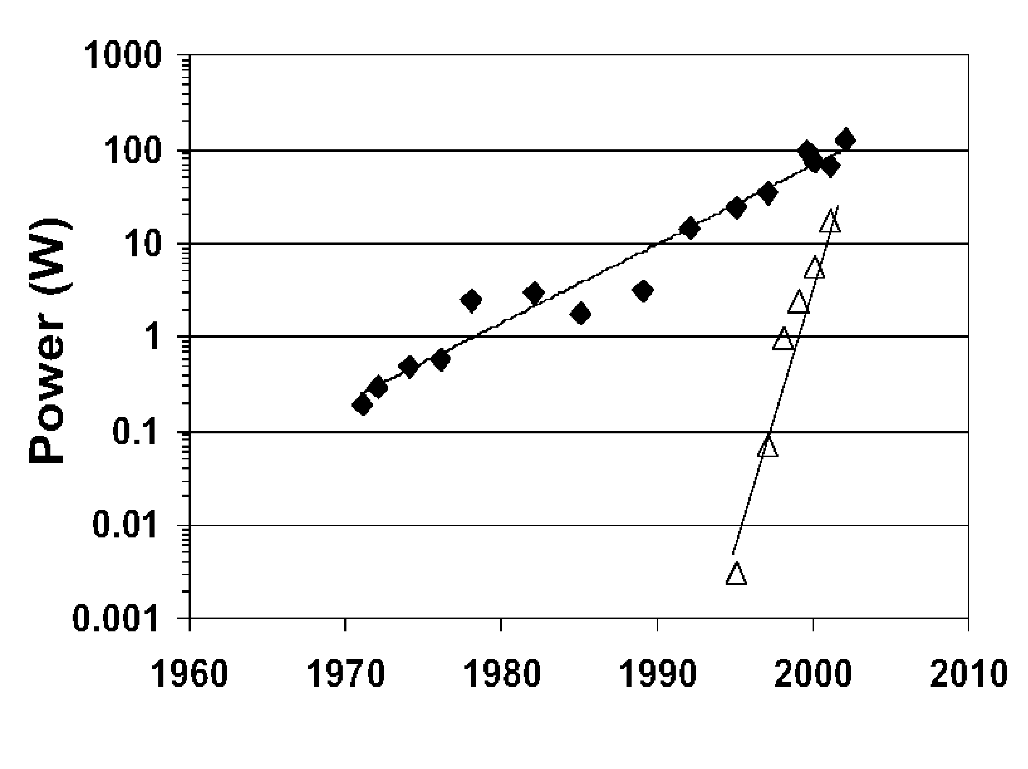
Static Power
V_{DD} decreases
  Save dynamic power
  Protect thin gate oxides and short channels
  No point in high value because of velocity sat.
V_{t} must decrease to
maintain device performance
But this causes exponential
increase in OFF leakage
Major future challenge
Dynamic
Static
[Moore03]

Slide 53
Productivity
Transistor count is increasing faster than designer productivity (gates / week)
  Bigger design teams
    Up to 500 for a high-end microprocessor
  More expensive design cost
  Pressure to raise productivity
    Rely on synthesis, IP blocks
  Need for good engineering managers

Slide 54
Physical Limits
Will Moore’s Law run out of steam?
  Can’t build transistors smaller than an atom…
Many reasons have been predicted for end of scaling
  Dynamic power
  Subthreshold leakage, tunneling
  Short channel effects
  Fabrication costs
  Electromigration
  Interconnect delay
Rumors of demise have been exaggerated

Slide 55
Summary
Scaling
  Transistors
  Interconnect
  Future Challenges

